Slide 1
EVERYTHING YOU NEED TO NODE

Slide 2
WHAT ARE WE DOING HERE
the usual suspects
the unusual suspect
what you might suspect
Notes:
1:15

Slide 3

TARA Z MANICSIC
Developer Advocate – Progress
Google Developer Expert
Cincy Women Who Code
Cincy NodeSchool
Always Forward w dshaw
@tzmanics
Notes:
Cincy deduction
Check out nodeschool.io
Podacst on Tuesday merger
Slides & tosh @tzmanics
Rakia for 2
2:!5
*3:30

Slide 4
THE USUAL SUSPECTS
microservices
backend
backend microservices
Notes:
Node.js® is a JavaScript runtime built on Chrome's V8 JavaScript engine. Node.js is primarily used for non-blocking, event-driven servers, due to its single-threaded nature. It's used for traditional web sites and back-end API services
light, scalable and fast way to write scripts.
Microservices architecture is a way of developing an application as a group of independent, small, and modular services each of which runs a unique process and plays a specific role in the business logic.

Slide 5
realtime apps
games
machine learning
universal rendering
file reading/parsing
iot
THE UNUSUAL SUSPECTS
Notes:
2:30
*6:00

Slide 6
FOR
REALTIME
Notes:
Ryan Dahl, the creator of Node.js, was aiming to create real-time websites with push capability,
he gave developers a tool for working in the non-blocking, event-driven I/O paradigm.
After over 20 years of stateless-web based on the stateless request-response paradigm, we finally have web applications with real-time, two-way connections.
Node.js shines in real-time web applications employing push technology over websockets

Slide 7
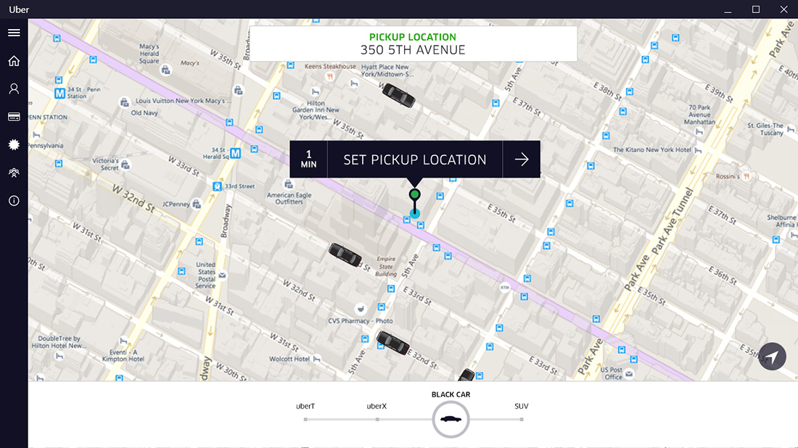
Notes:
Netflix, Walmart, paypal, linked in, ebay
To prove their Node.js app success, Uber is now able to process over 2 million remote procedure calls (RPC) per 1 second. Even at peak times. Impressive!
Node.js is excellent for the development of such streaming applications thanks to its native Stream API. In particular, Node.js has an interface of readable and writable streams that can be processed and monitored very efficiently. Stream instances are basically Unix pipes that allow transmitting parts of the app’s executable code to the local machine while keeping a connection open for new components to download on demand.

Slide 8
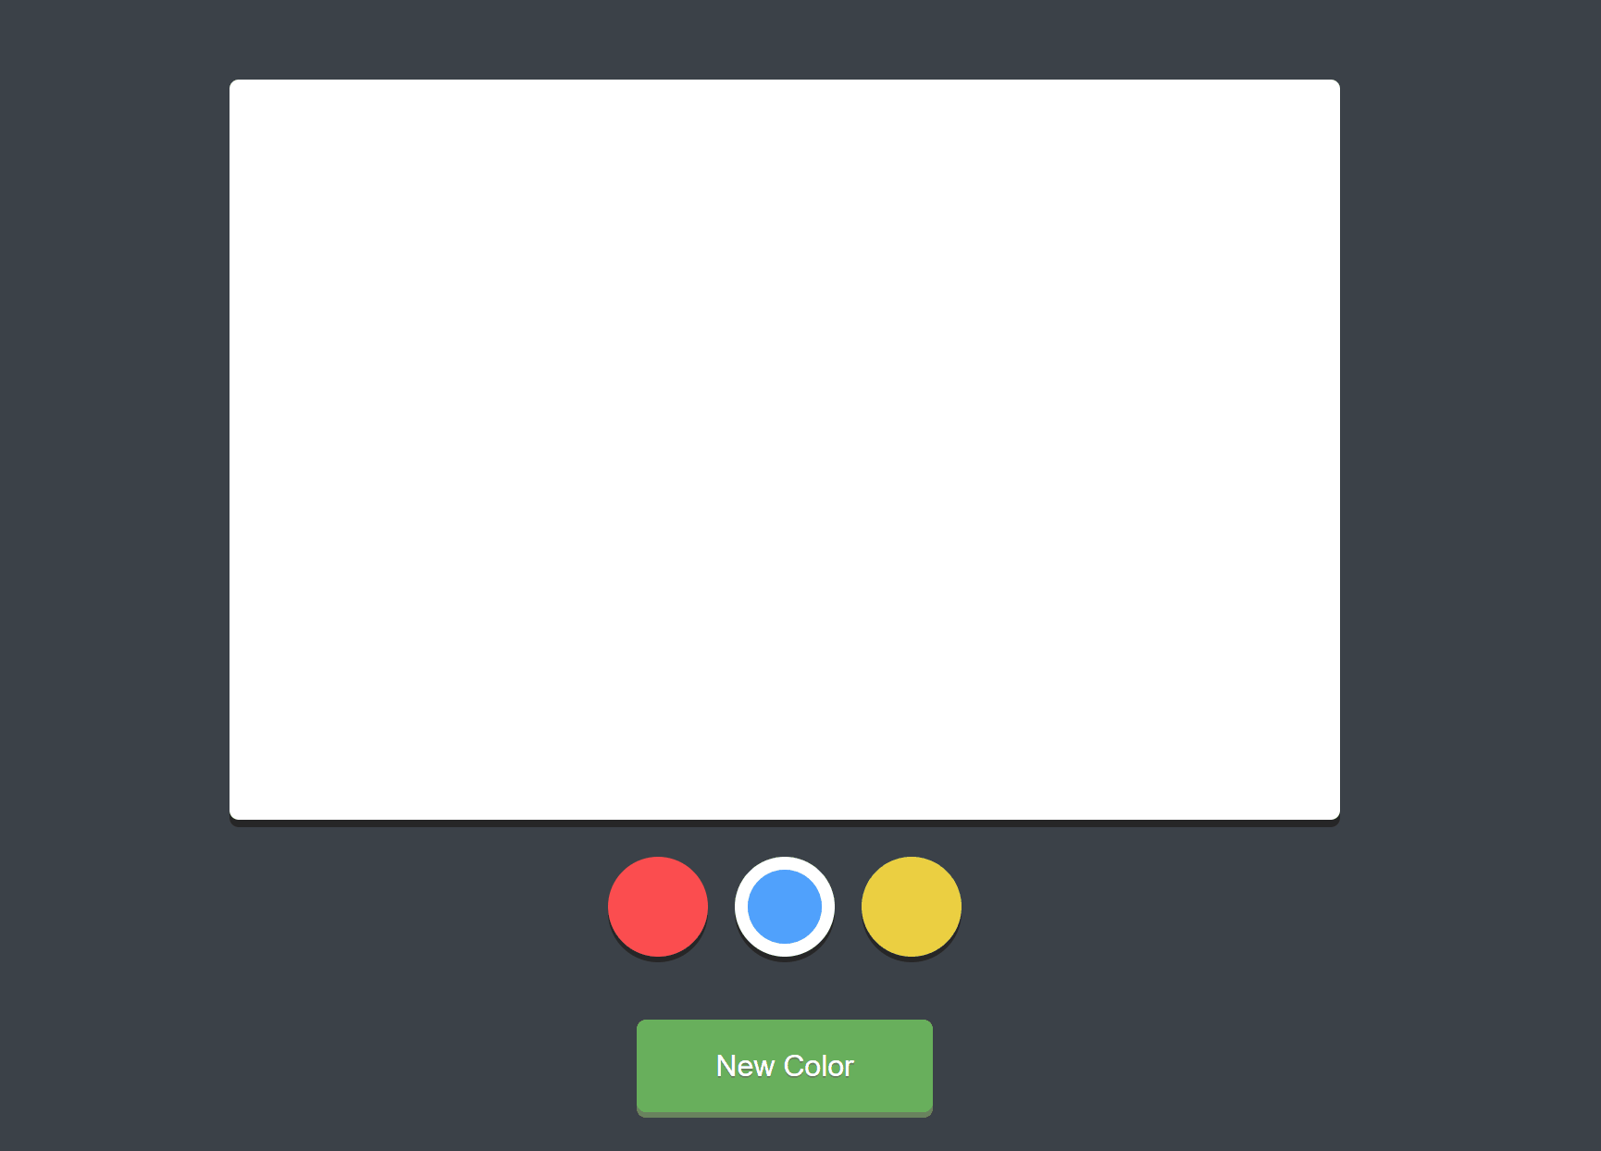
http://drawwithme.herokuapp.com
Notes:
5:00
*11:00
Node’s event-based architecture also works well with the WebSockets protocol that facilitates a fast two-way exchange of messages between the client and the server via one open connection.
By installing WebSockets libraries on the server and the client side, you can implement real-time messaging that has lower overheads and latency, and faster data transfer than most other, more conventional, solutions.
As in the case of the real-time chats, Node’s asynchronous and event-based architecture is a great fit for collaboration apps.

Slide 9
ITS ALL FUN AND GAMES
Notes:
Node.js is a great fit for SPAs thanks to its efficient handling of asynchronous calls and heavy I/O workloads characteristic of these applications. Node.js’s event loop allows to “delay” multiple concurrent requests from the client, which ensures smooth transitions between views and seamless data updates. Also, Node.js works well with data-driven SPAs, where the server acts as a backend that provides data to the client whereas the client does all the HTML rendering.

Slide 10
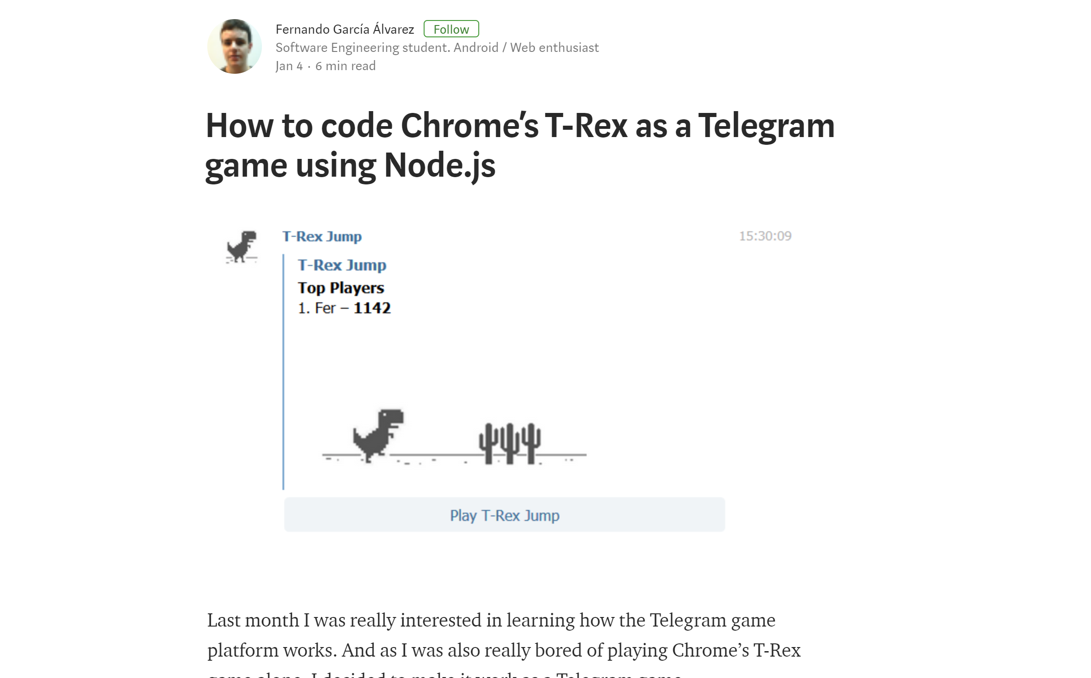

Slide 11
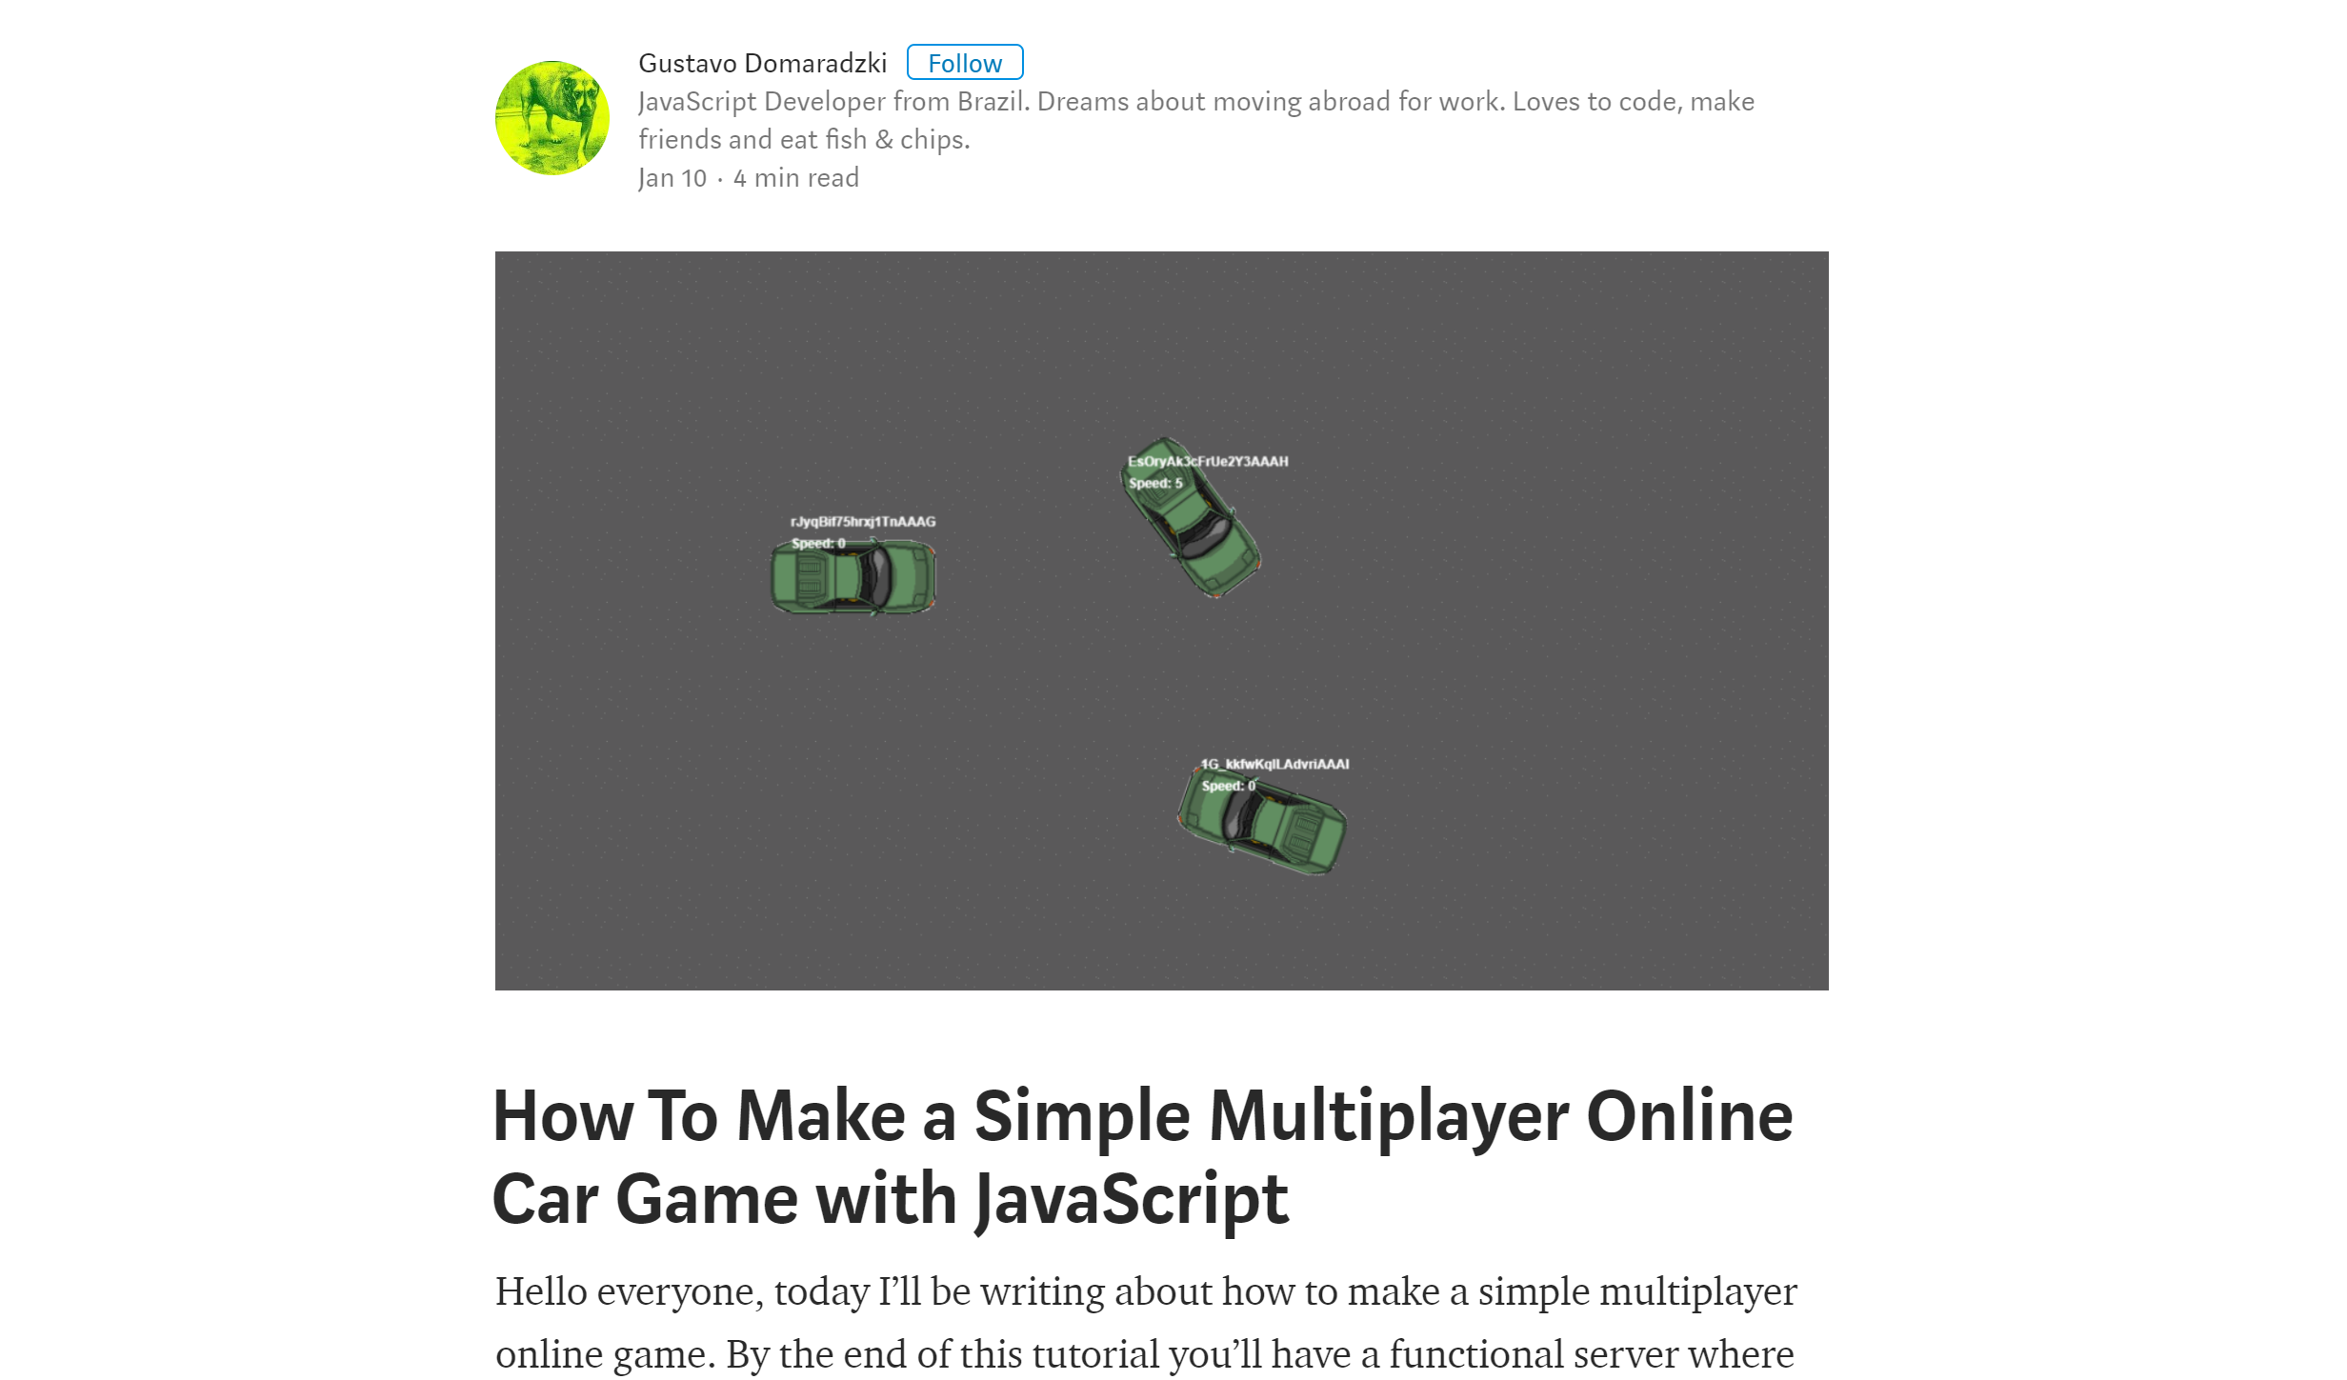
Notes:
3:00
*14:00

Slide 12
LEARNING MACHINE LEARNING

Slide 13
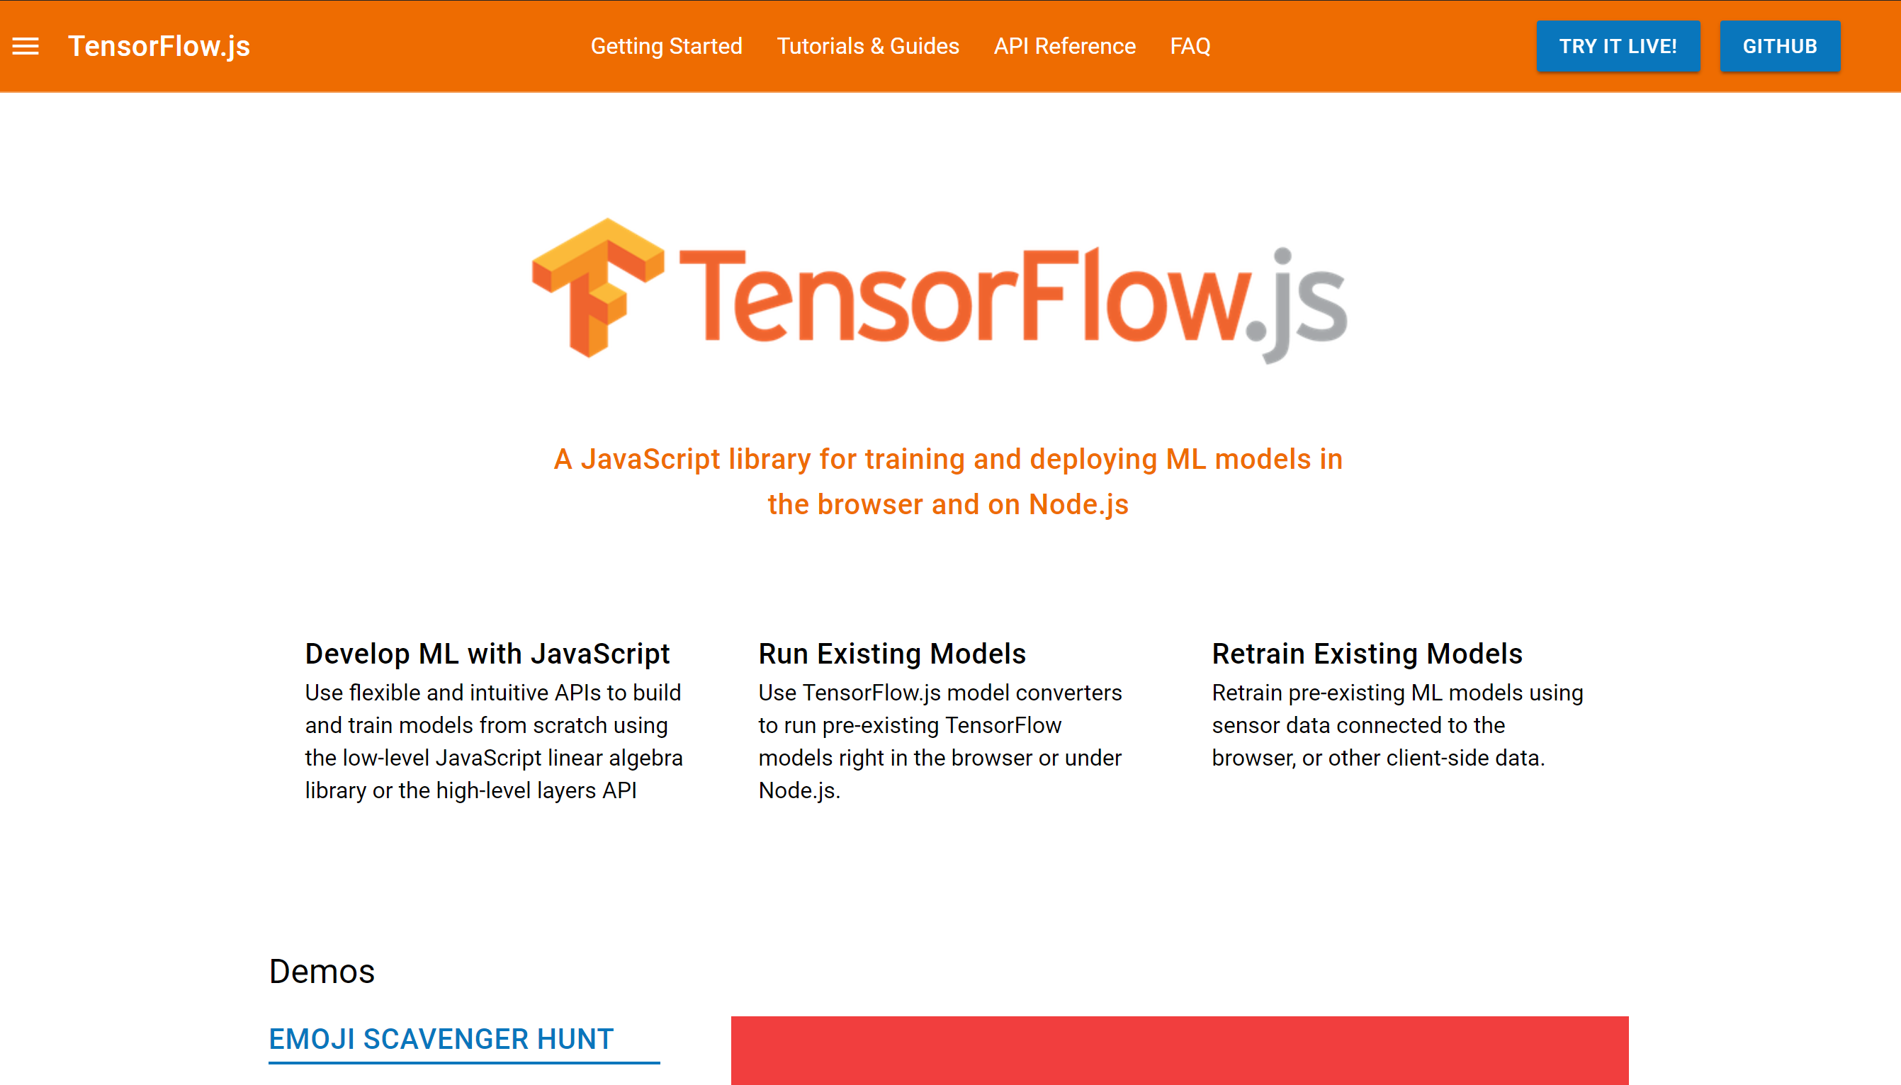
Notes:
TensorFlow.js. A JavaScript library for training and deploying ML models in the browser and onNode.js.

Slide 14
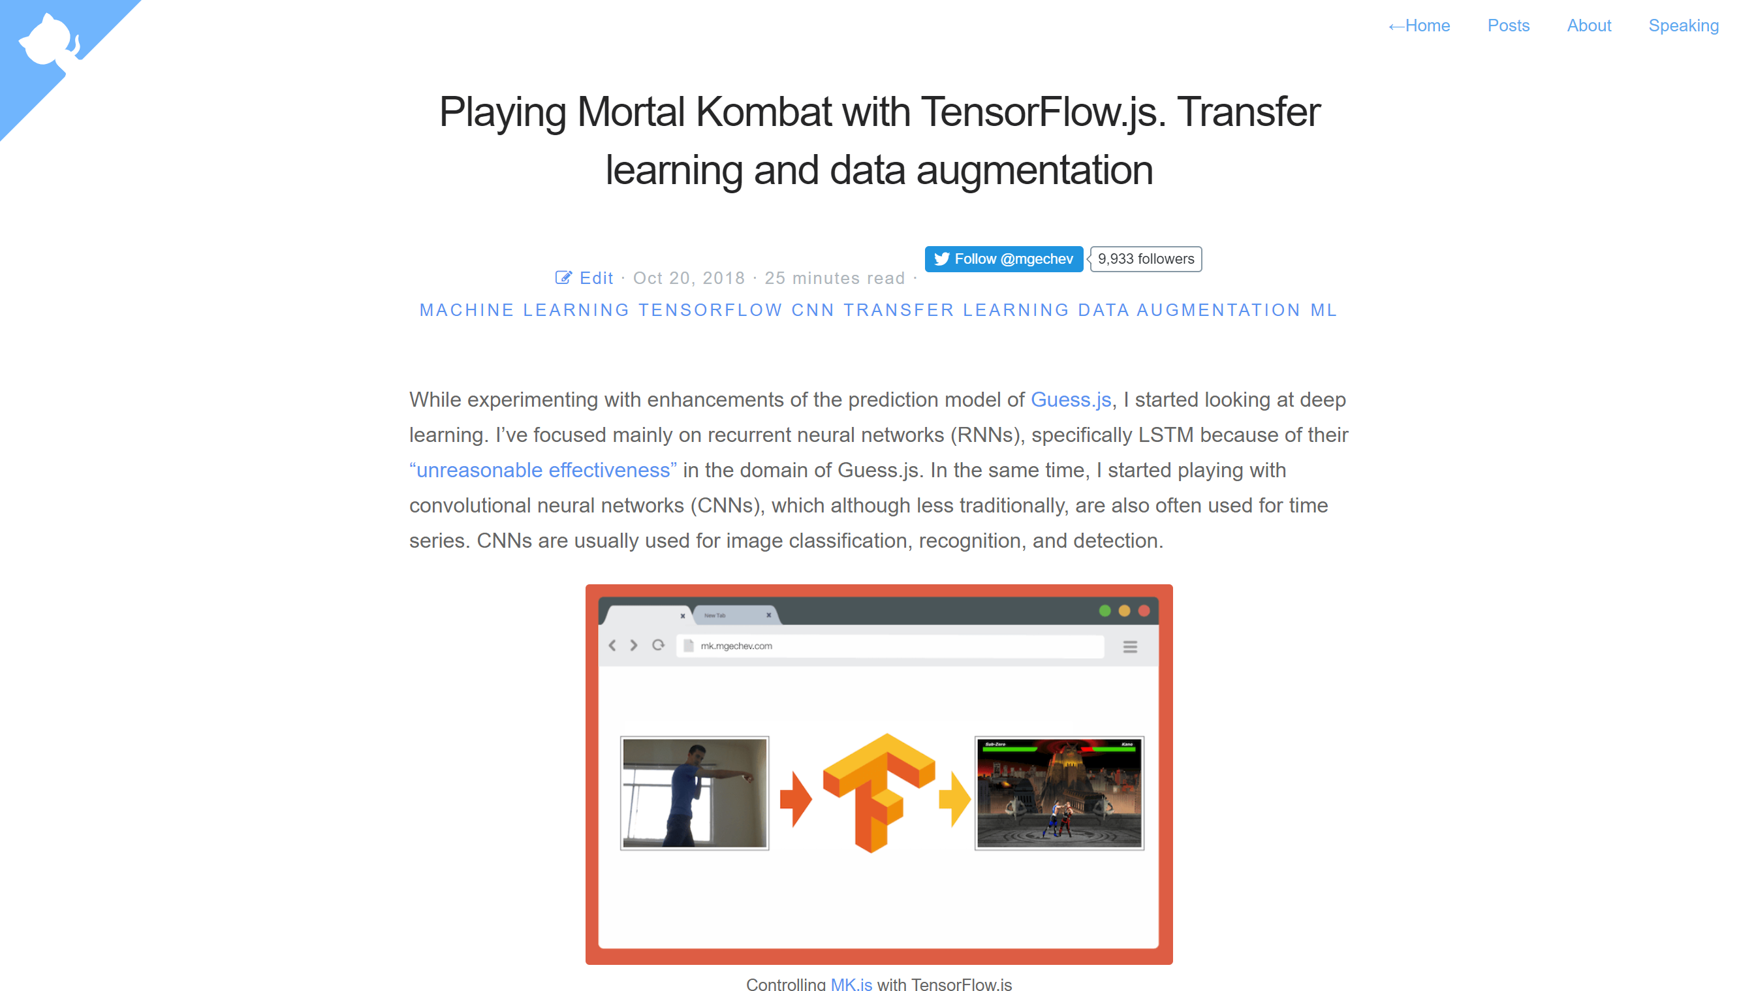
https://blog.mgechev.com/
Notes:
Collecting training data for image classification
Performing data augmentation using imgaug
Transfer learning with MobileNet
Binary classification and n-ary classification
Training an image classification TensorFlow.js model in Node.js and using it in the browser
Few words on using action classification with LSTM

Slide 15
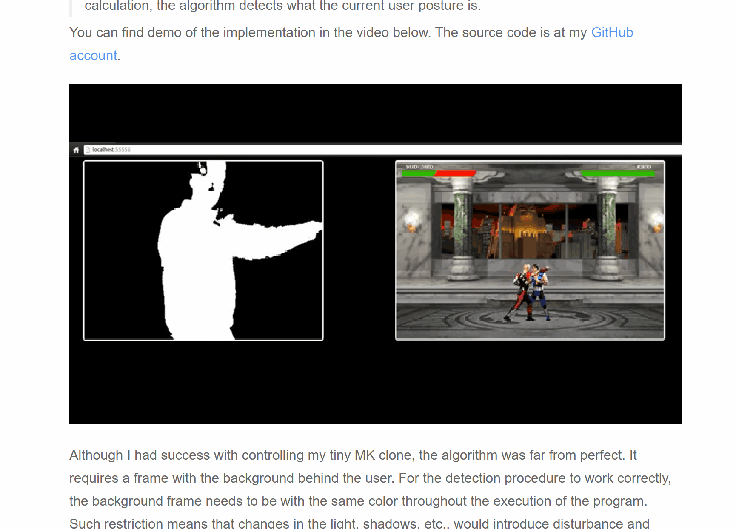
Notes:
Training an image classification TensorFlow.js model in Node.js and using it in the browser
3:00
*17:00

Slide 16
TAKING OVER THE UNIVERS AL
RENDERING

Slide 17
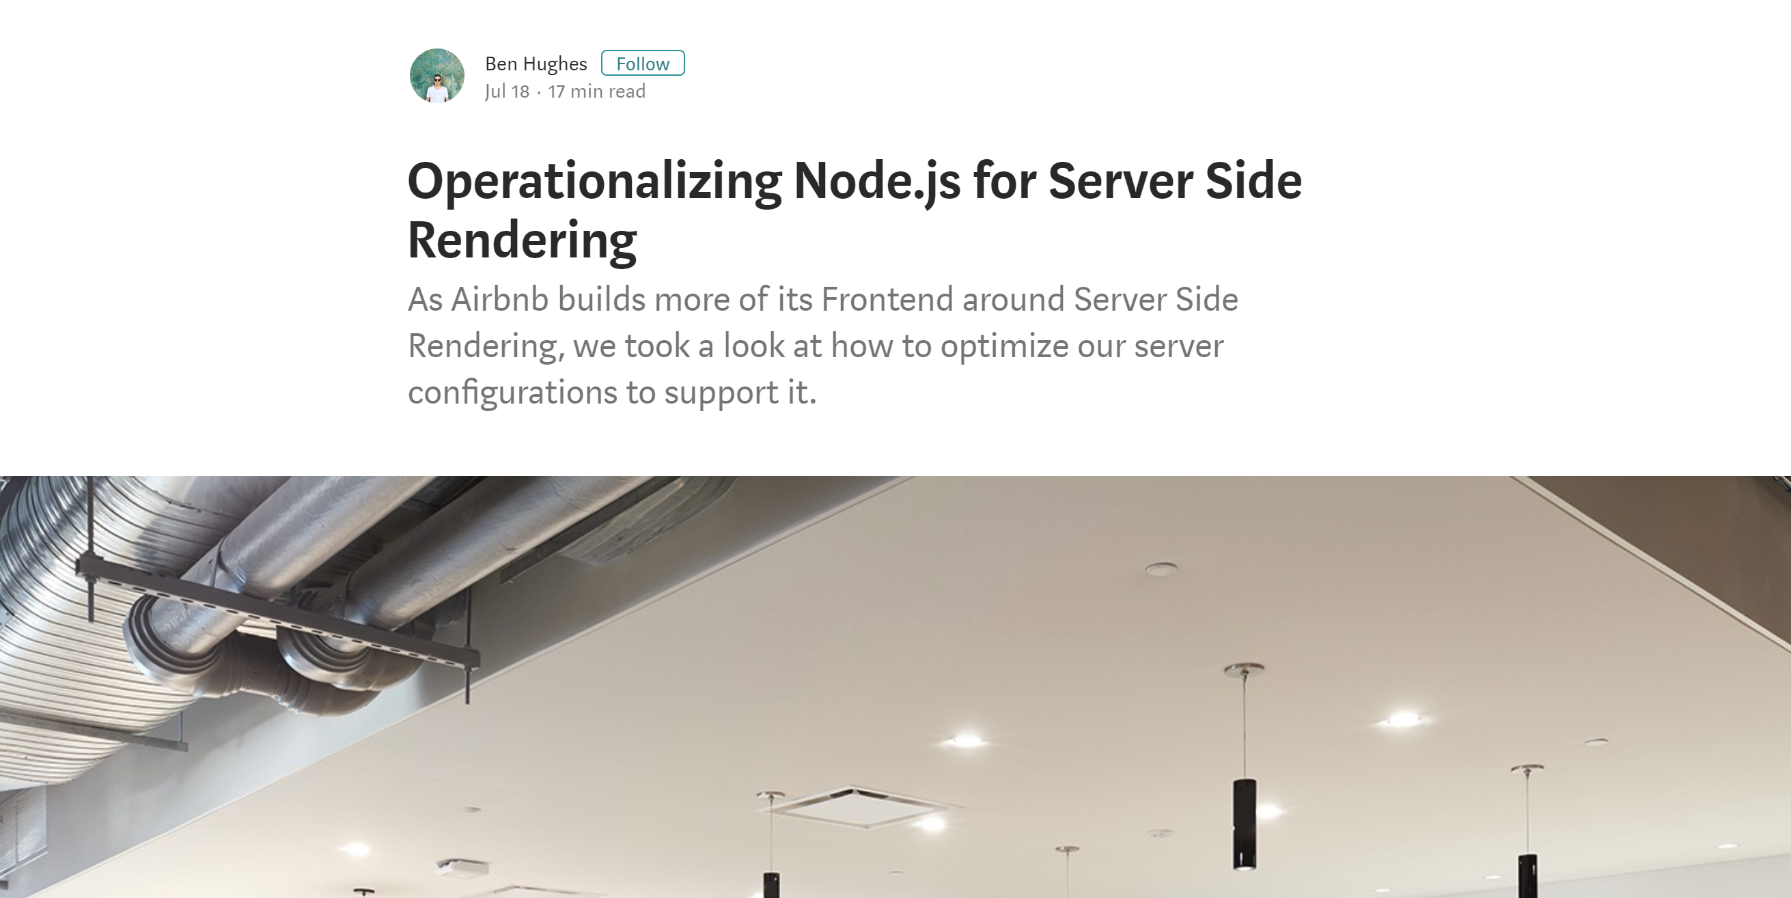

Slide 18
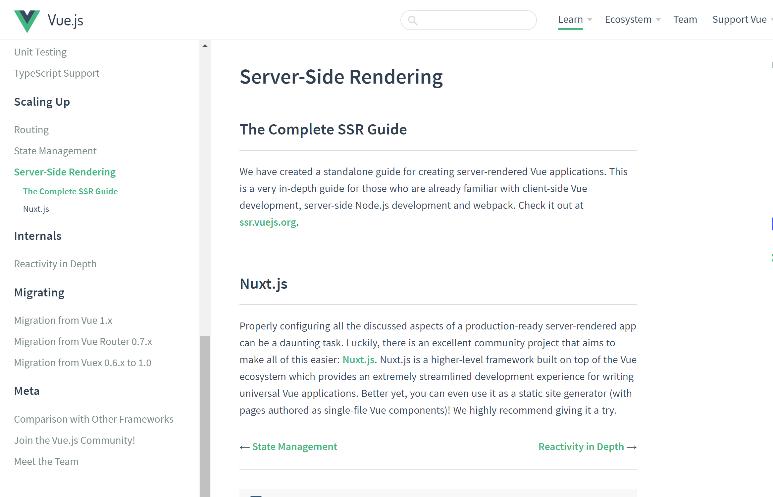
Notes:
This is a very in-depth guide for those who are already familiar with client-side Vue development, server-side Node.js development and webpack.

Slide 19
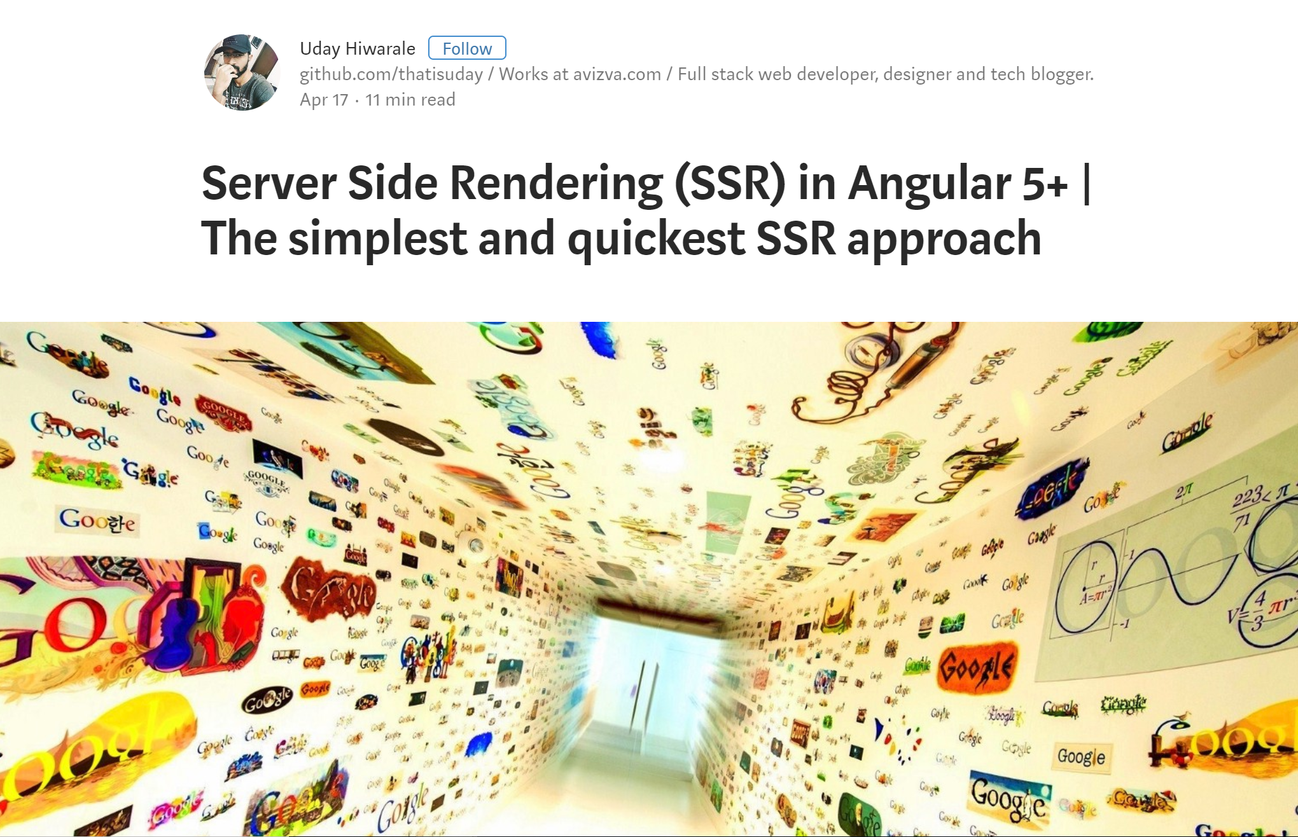
Notes:
So in this article, I will explain step by step implementation of server side rendering with some examples.
4:15
*21:15

Slide 20
FILE READING N
PARSING

Slide 21
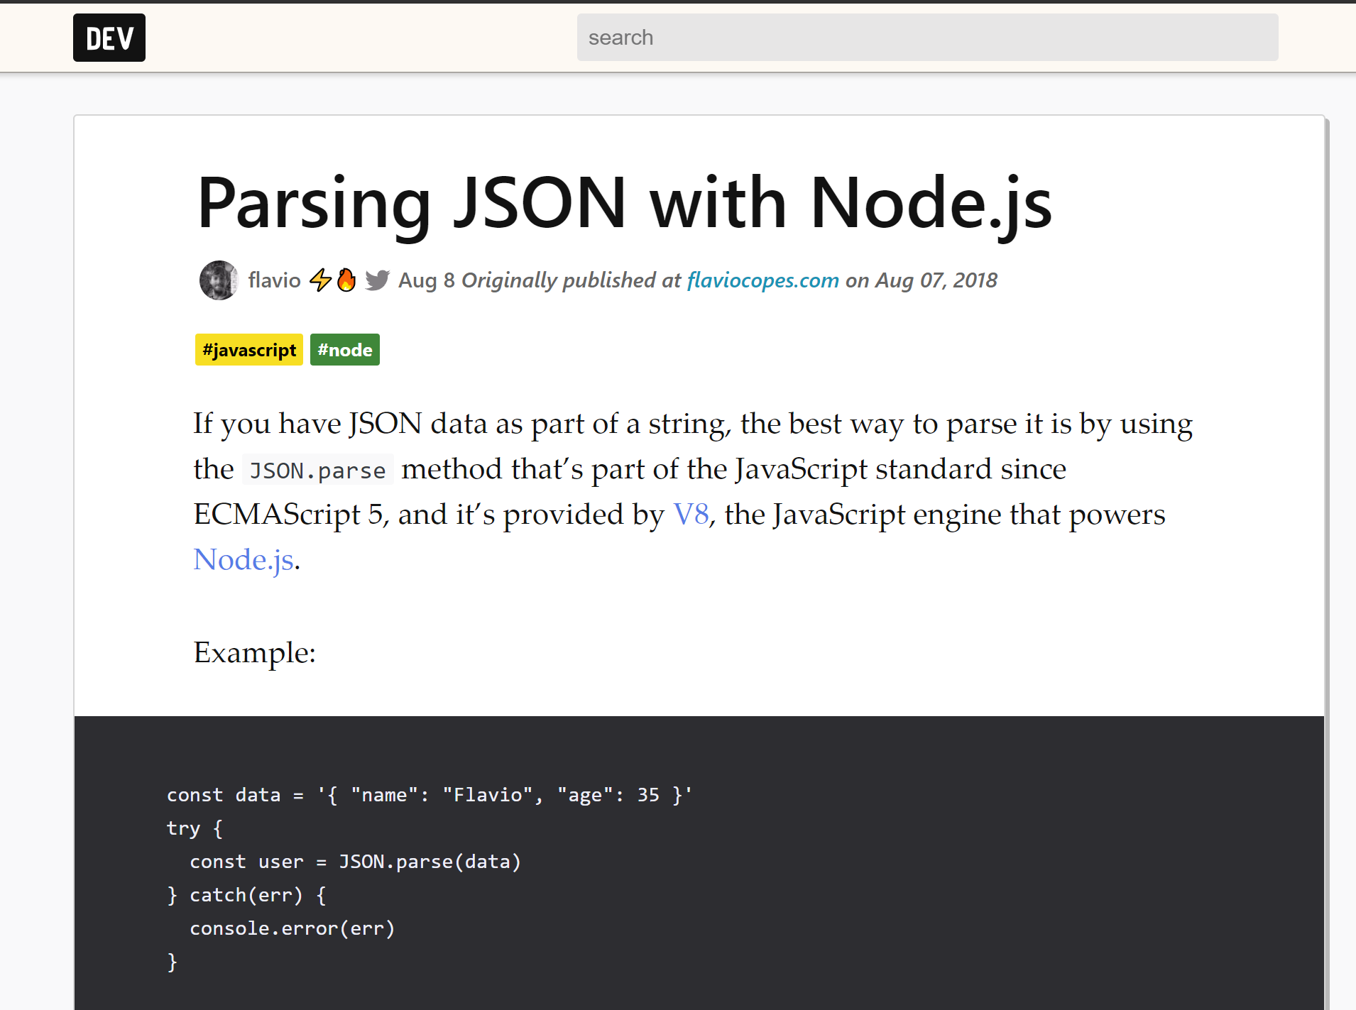

Slide 22
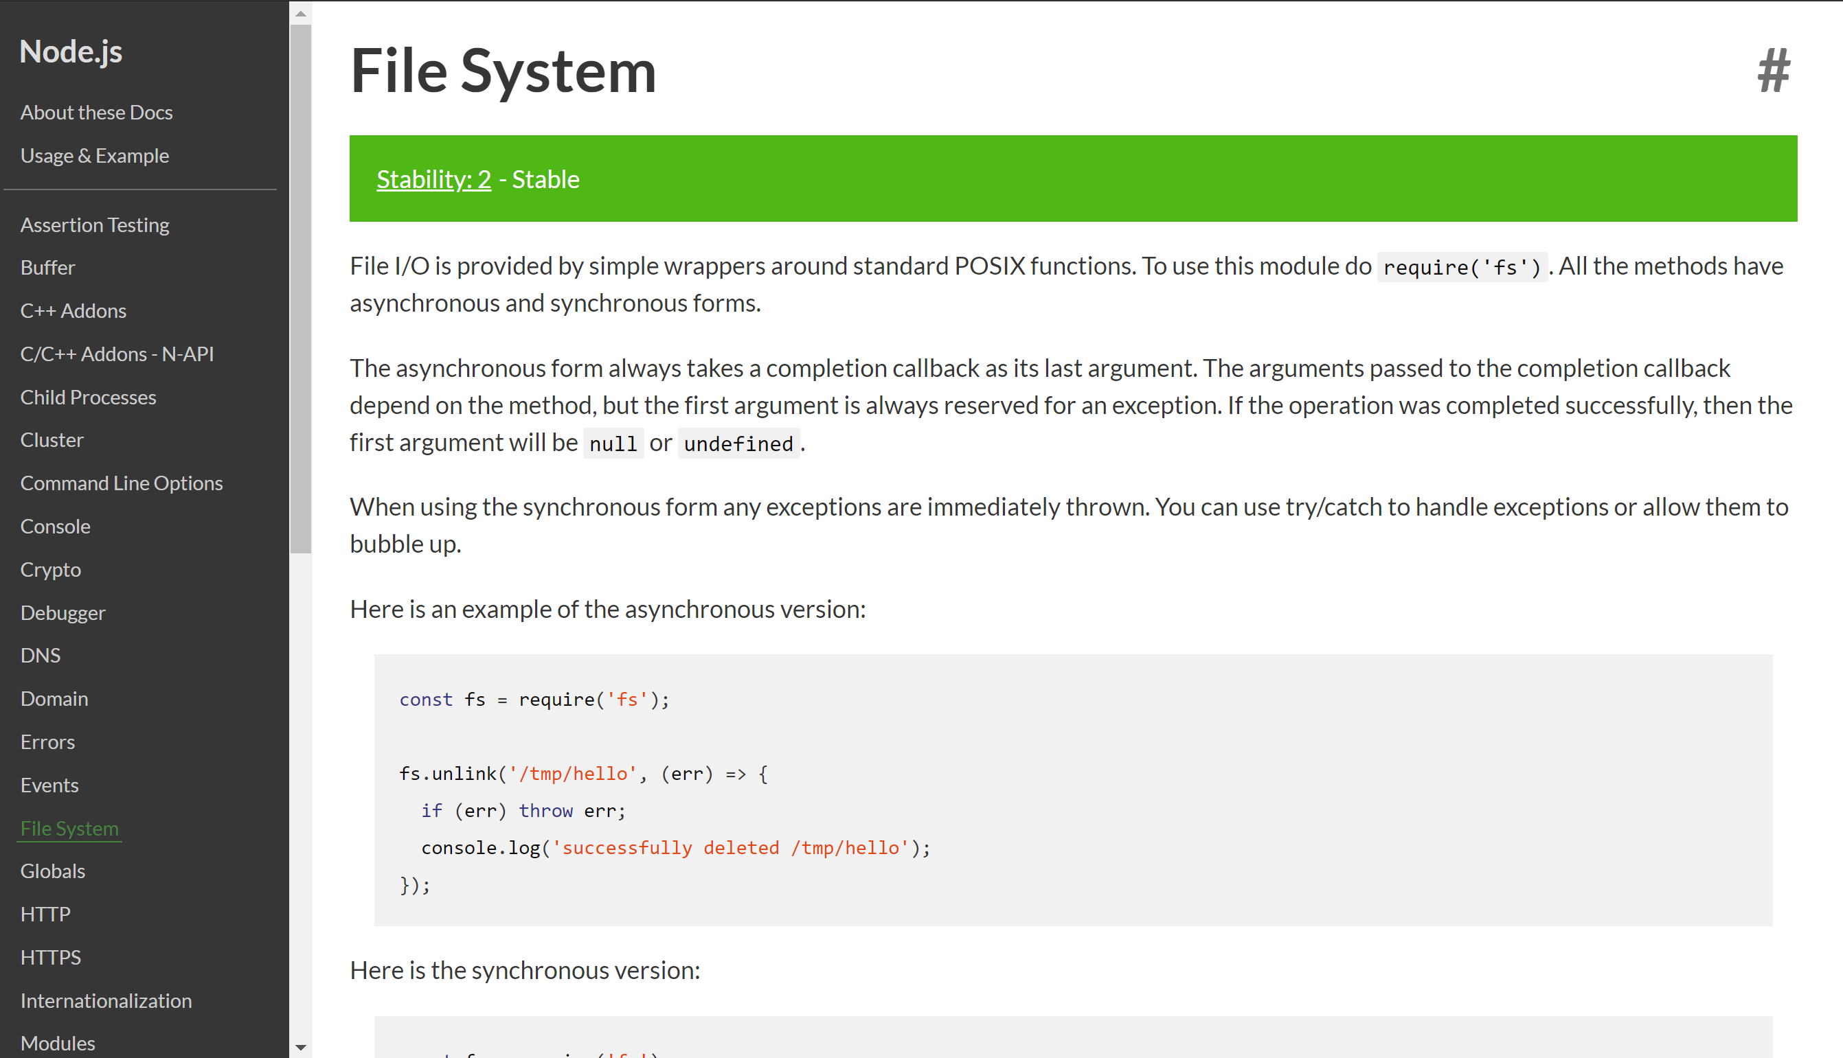
https://nodejs.org

Slide 23
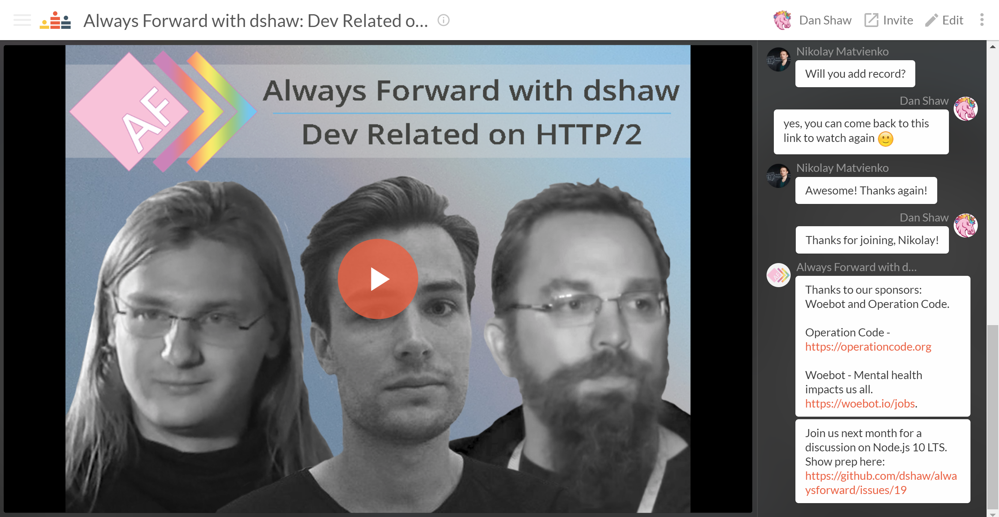
https://www.crowdcast.io/e/dshawaf8
Notes:
ana Henningsen
2:30
*23:45

Slide 24
IOT FOR YOU AND ME
Notes:
The most obvious advantage of Node.js as a back-end for such networks is its ability to process multiple concurrent requests and events emitted by thousands or even millions of devices on the network.
The avalanche of requests and data coming from IoT devices does not block Node.js servers thanks to their event-driven architecture and asynchronous processing suitable for I/O-heavy operations on the IoT network. This makes Node.js fast as an application layer between these devices and databases used to store data originating from them.

Slide 25
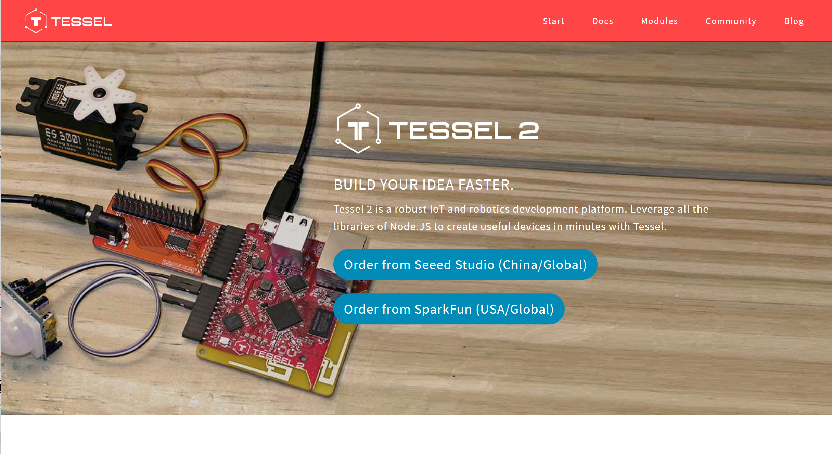
https://tessel.io/

Slide 26
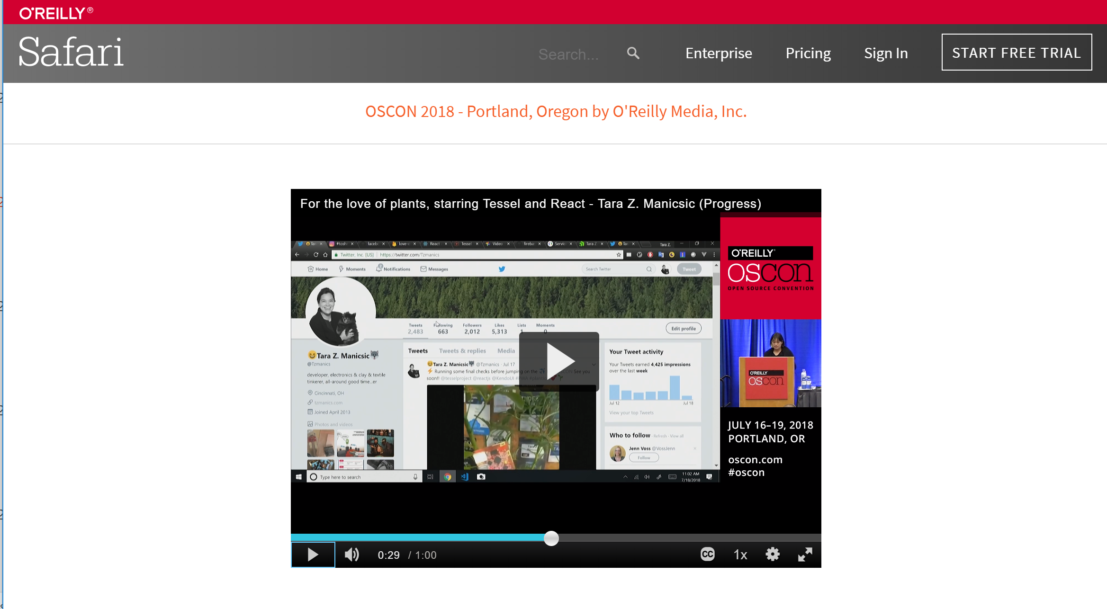

Slide 27
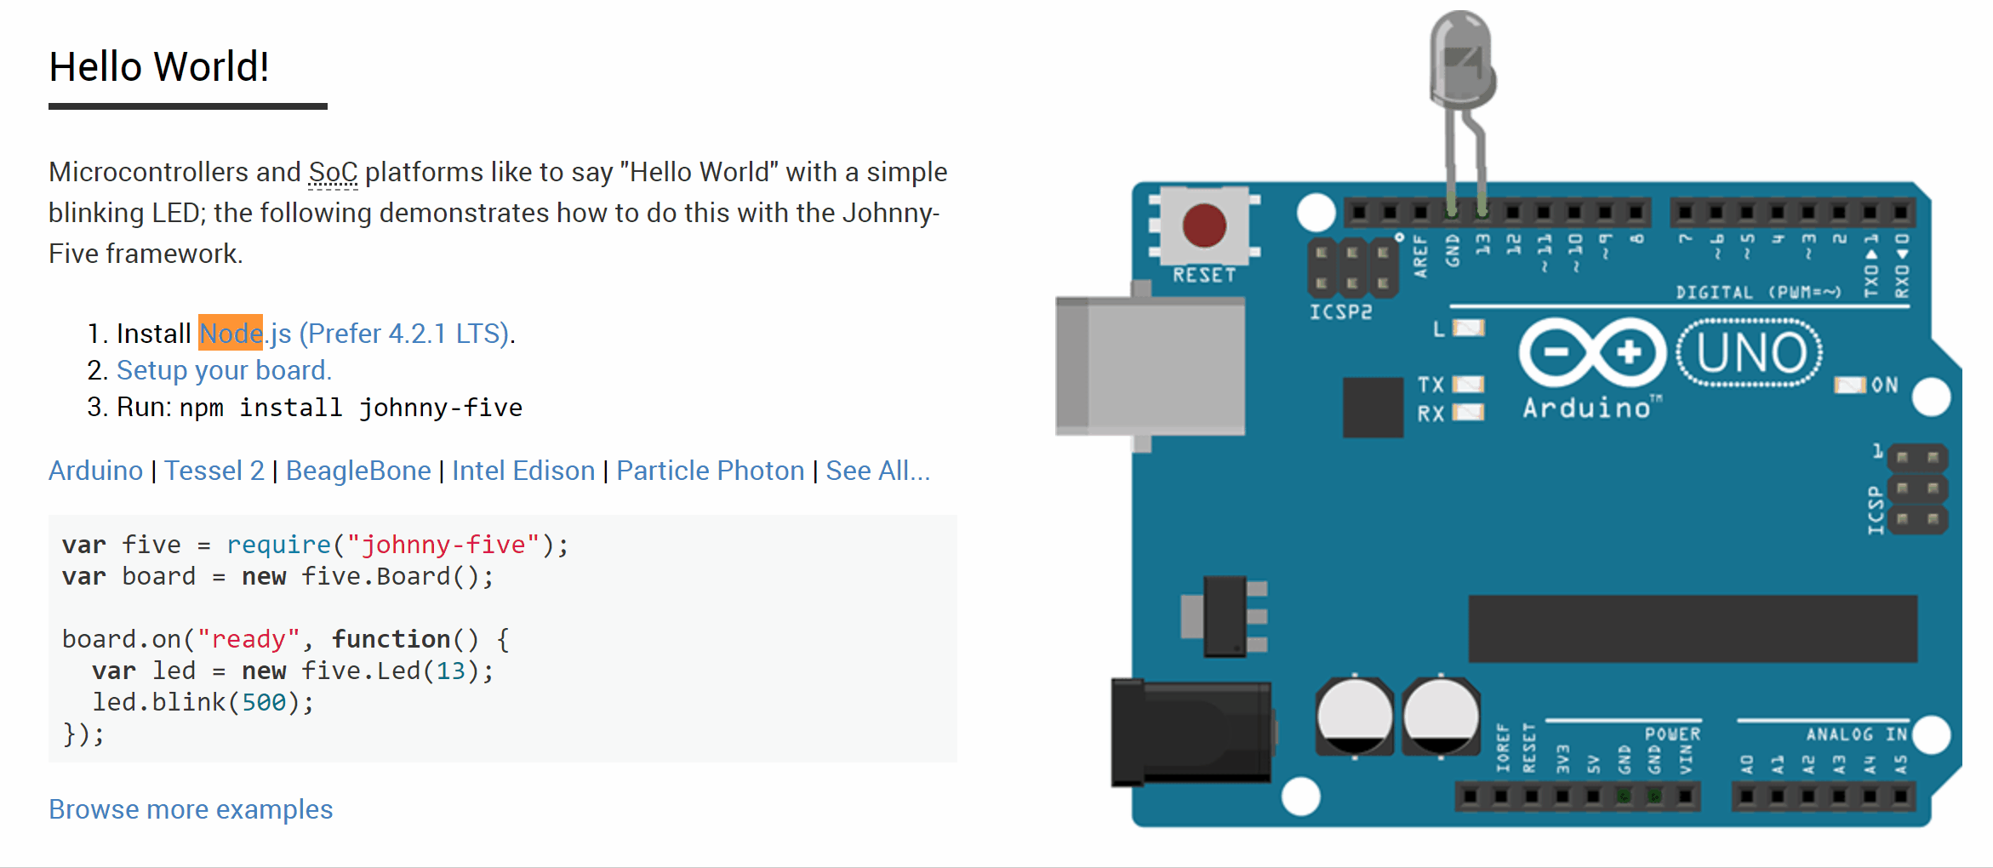
http://johnny-five.io
Notes:
Johnny-Five is the JavaScript Robotics & IoT Platform. Released by Bocoup in 2012, Johnny-Five is maintained by a community of passionate software developers and hardware engineers. Over 75 developers have made contributions towards building a robust, extensible and composable ecosystem.
5:15
*29:00

Slide 28
CODING
TIME

Slide 29
REALTIME
VUE N NODE CHAT PWA
Notes:
Talk about PWA
Jo’s talk
Ray’s series on progress blog
2:00
*31:00

Slide 30
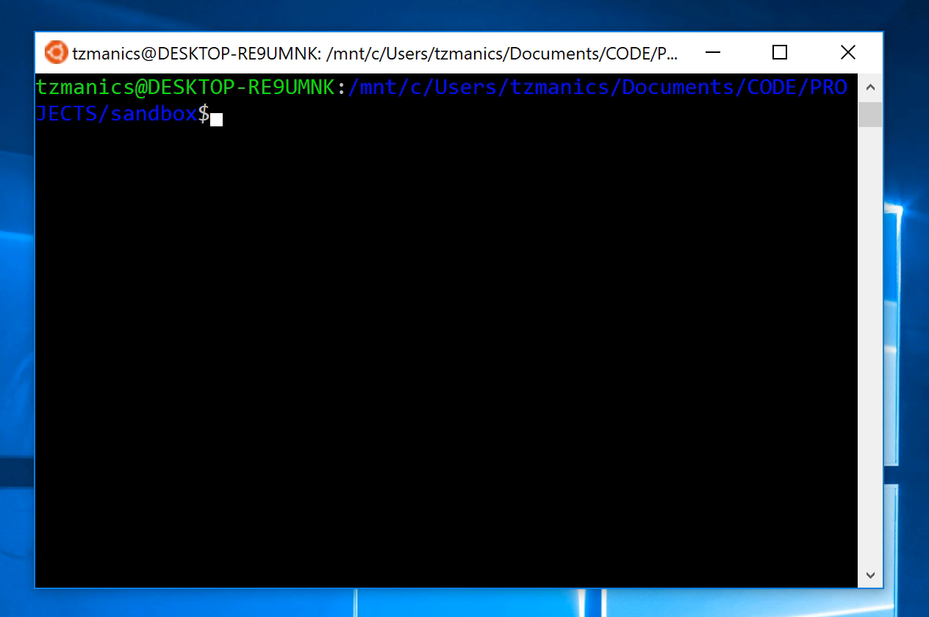

Slide 31
https://bit.ly/2z4xDbD
https://github.com/tzmanics/tosh-my-gosh/
Notes:
2:00

Slide 32

THANK YOU?
OH YOU’RE
WELCOME!
SLIDES @TZMANICS
Notes:
:30
*45:00

